Slide 1
Chicago Car Crashes
By Olaide Kashimawo

Slide 2
Outline
Business Understanding
Data
Exploratory Data Analysis
Result
Recommendation

Slide 3
Business Understanding
This project seeks to create a multi-classification model to accurately identify the primary contributory cause of car crashes in Chicago
I will analyze the data of car crashes to determine which factors are most likely to lead to injury and build a predictive model to alert help emergency medical services dispatchers of the potential injury.

Slide 4
Data
According to statistics from the state of Chicago department of transportation in 2022
with an average of 70,000 reported each week and 20,000 crashes caused injuries
Chicago department of transportation Crash Dataset contains almost 500,000
There were three datasets that we observed, "Traffic Crashes - Crashes", "Traffic Crashes - Vehicle", and "Traffic Crashes - People" which were merged into one data.

Slide 5
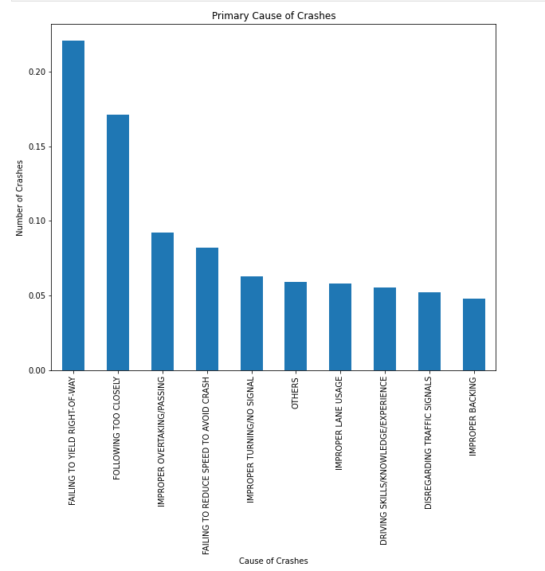
Primary Causes of Crashes
Some major causes of crashes are;
failing to yield the right of way
following too closely
improper overtaking/passing
failing to reduce speed to avoid a crash

Slide 6
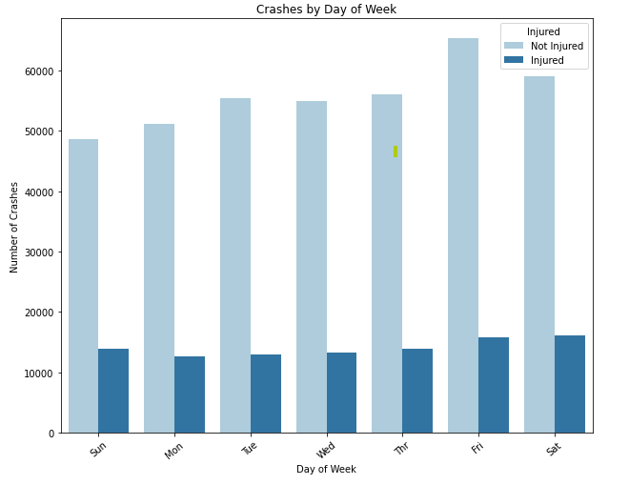
Crash day of the week Relationship between crashes and injury
Most accidents occurred on weekends mainly(on Fridays and Thursday)

Slide 7
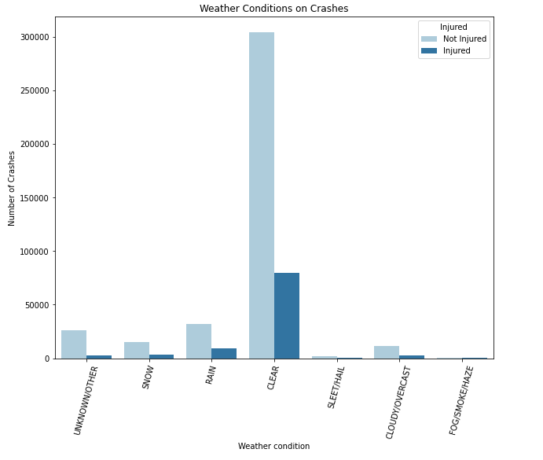
Weather Conditions Relationship between Weather conditions and injury
Most accidents occurred on weekends mainly(on Fridays and Thursday)
From the visualization above we can see most crashes happens in broad daylight

Slide 8
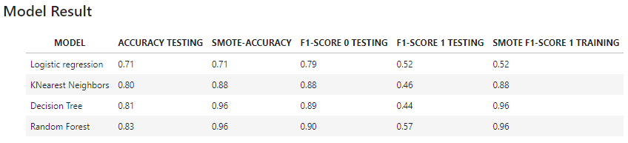
RESULT
Overall, it seems that the resampling technique using SMOTE has significantly improved the performance of the Decision Tree and Random Forest models, as shown by their high F1 scores on the resampled data.

Slide 9
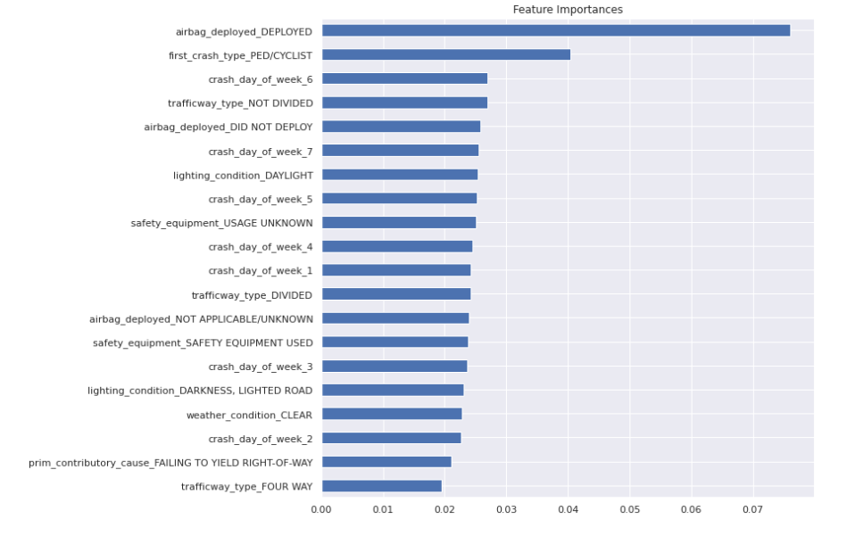
Feature Importance's
The airbag deployed
Pedestrians/Cyclist, and
Traffic ways not divided have the highest coefficients with
injuries occur mostly on Saturdays
.

Slide 10
Recommendations
Increase enforcement of traffic laws and regulations, particularly with respect to distracted driving and failure to maintain a proper lane.
Installation of physical barriers between opposing lanes of traffic, wider lanes, and better marking of lanes and road edges.
Encourage the use of advanced driver assistance systems (ADAS) for instance blind spot detection, lane departure warning, and automatic emergency braking.
.

Slide 11
Next Step
To further analyze to better understand the factors that contribute to crashes;
Analyze driver behavior and roadway design.
Binning data to find crash locations can suggest lowering a speed limit or adding a traffic signal soon.
.

Slide 12
Thank you! GitHub link: HTTPs://github.com/olaidekashimawo/ Email: goldprint3@outlook.com
.

